Slide 1
What Do Middle Graders
REALLY Need
To Be On The Path to Career Readiness?
Educating for Careers
March 3, 2014
Rebecca Dedmond,
George Washington University &
The Freshmen Transition Initiative
David Militzer
Education Programs Consultant
High School Initiatives and Initiatives Office
California Department of Education
.
Notes:
.

Slide 2
A Change Environment
Everybody
Take a Deep Breath

Slide 3
State Programs Eliminated* Under New Funding System
Grade 7 – 12 Counseling, Gifted and Talented Education, Civic Education, Economic Impact Aid, High School Class Size Reduction, Principal Training, Professional Development Block Grant, School and Library Block Grant, Professional Development for Math and English, School Safety, Student Councils, Summer School Programs, Teacher Credentialing Block Grant, AVID, et. al.
CTE funding (Ag Incentive Grants, Regional Occupational Centers and Programs): funding held harmless for two years (2013 – 2015), then included in Local Control Funding Formula.
*Dept. of Finance
Notes:
No accountability or tracking of ROCP $$.

Slide 4
Deja vu
“Funding dispute threatens health, counseling program”
School nurses, speech pathologists, counselors and psychologists throughout CA face pink slips this Spring as districts struggle to close a 600 million gap created by a withholding of federal funds…..”

Slide 5
100 Students Start 9th Grade
51 are on a “college prep” track
75 graduate from high school
51 enter college
38 need Remediation
26 graduate with degree
50% of recent grads working in jobs requiring only H.S. diploma
US Dept. of Education and Heldrich Center, Rutgers University

Slide 6
Research has clearly indicated that CTE is a critical component of a broad and deep school curriculum that addresses career and college readiness. CTE proven models for assisting LEAs in offering programs and curricula consistent with the Common Core, Local Control Funding Formula and Local Control Accountability Plan. It provides relevance and real world content for academic studies while promoting teamwork and cooperative learning. It builds student, teacher, counselor, parent, business, and community engagement. And it encourages students to see a high school diploma and readiness for college or other postsecondary study as a foundation for the future rather than an end in and of itself. It is popular with elected officials, parents, business, and knowledgeable educators.
.
.
Notes:
TABLE TALK
.
Do we have a consensus about priorities?
Do we have a consensus about resource allocation?
Do we have a plan to reduce fragmentation and increase synergy, coherence, and strategic leveraging?
Do we have agreement about what is working and what isn’t working?
6

Slide 7
YET……
Despite the ongoing popularity of Career Technical Education, CTE has been declining for over 20 years

Slide 8
CTE in California
In California High Schools, between 2011 -12 and 2012-13, CTE student enrollment dropped by 11.8%
There was a 11.1% decrease in CTE courses
The number of CTE Credentialed Teachers fell by 19.6%
No data on Middle Grades available

Slide 9
Since Publication of A Nation At Risk
These have been main drivers effecting school reform:
Higher Standards
Higher Expectations (for students, schools, and increasingly teachers)
Higher Accountability (with negative motivators)
Narrowing of the Curricula
Focusing on evaluation of Teachers linked to high stakes Testing
Budget cuts
.
Notes:
TABLE TALK
.
Do we have a consensus/broad agreement about how we determine priorities?
Do we have a consensus/broad agreement about how we allocate resources?
In our current system is the whole greater then the sum of it’s parts? How does this happen? Or if not, why not?
Do we have agreement about what is working and what isn’t working?
9

Slide 10
Current K-12 Reform Efforts
Common Core
Broadened Assessments
Funding Equity
Funding Flexibility
Career and College Ready
Notes:
Concentrsting on some of the implications of Funding Flexibility under the LCFF
And delving into Career Readiness, for all students – including resources, opportunites, and a few examples of sound practice.
We will also use the P21 initiative and movement along with guideposts that are generally supported by current research for transforming our schools
First, two brief anecdotes that will hopefully help us transition into the rest of the material.
The fist is a tale of two fish the late author David Foster Wallace told to a commencement address several years ago.
The second is from the movie up.
10

Slide 11
Using Effective Policies to “Drive” Reform
Good Drivers
Capacity Building
Group Work
Instruction
Systems Solution
Michael Fullan
Notes:
#2 See “Wrong Drivers for Whole System Reform”
Not saying policies that are bad drivers are necessarily bad policies – they may have their place, but not behind the wheel.

Slide 12
Good Drivers
Cause Whole System Improvement
Are Measureable in Practice and Results
Clear Case Can Be Made
Michael Fullan
Notes:
Play Savanna High Video of SSPI Visit
Cites these as bad drivers:
Temptation to overly focus on standards, accountability, rewards and punishments
Teacher evaluations based on test scores
Technology driving change
Fragmented rather than integrated strategies
Also note any policy can flounder with bad implementation.

Slide 13
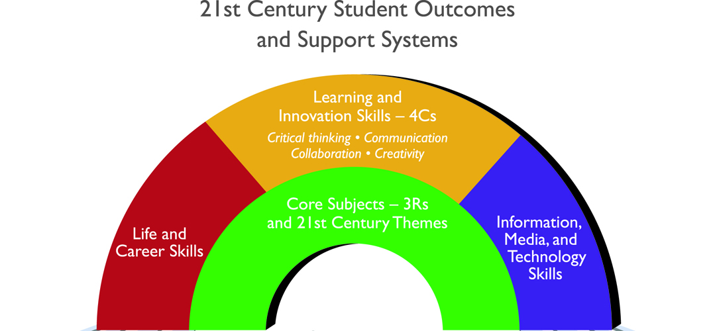
.
Notes:
13
(4) 21st Century Skills 1 pager
The Framework presents a holistic view of 21st century teaching and learning that combines a discrete focus on 21st century student outcomes (a blending of content knowledge, specific skills, expertise and literacies) With innovative support systems to help students master the multi-dimensional abilities required of them in the 21st century.
The graphic represents both 21st century skills student outcomes (as represented by the arches of the rainbow) and 21st century skills support systems (as represented by the pools at the bottom).
Although this may appear complex, the anchor of the P-21 movement is to simply embed the 4 c’s into the k-12 education of all students.

Slide 14
Notes:
Many existing relevant resources not well understood outside of those already with strong CTE/Pathways
Starting place is to have a “map” of where and how career development relates to education.

Slide 15
Standards for Career Ready Practice
Adapted from the National Career Technical Common Core
Align with Skills for the 21st Century
Describe the fundamental knowledge and skills needed to be ready for careers AND college
Adapted from the National Common Career Technical Core
Not exclusive to a career pathway, CTE program of study, a particular discipline, or grade level
Notes:
The Standards for Career Ready Practice are adapted from the National Common Career Technical Core; over 42 states were involved in the development of these practices. The twelve Standards for Career Ready Practice reflect the expectations from business and industry, labor, community, and education representatives from over 40 participating states and align with the CTE anchor standards.
These new Standards for Career Ready Practice were adopted for California and based on the “Career Ready Practices” adopted by the Common Career Technical (CCTC). The CCTC practices are posted at: http://www.careertech.org/
These were derived from the Secretary’s Commission on Achieving Necessary Skills (SCANS) Report first published in the 1990’s.

Slide 16
Standards for Career Ready Practice
Increase in complexity and expectation as student advance through a program of study
Are taught and reinforced in all career exploration or career preparation programs, or integrated into core curriculum
For ALL students, not just CTE students
Notes:
The Standards for Career Ready Practice can be integrated with a course or incorporated into several courses over multiple school years (grades seven through twelve). The practices are expectations for all students, whether they are enrolled in a CTE program or following a more generalized course sequence. It is expected that all students who exit high school will be proficient in these practices.

Slide 17
Standards for Career Ready Practice
Apply appropriate technical skills and academic knowledge
Communicate clearly, effectively, and with reason
Develop an education and career plan aligned to personal goals
Apply technology to enhance productivity
Utilize critical thinking to make sense of problems and persevere in solving them
Practice personal health and understand financial literacy
Notes:
Standards for Career Ready Practice: reference pages 11 & 12 of the CTE Model Curriculum Standards Executive Summary.
Cue audience to pull out/ or pass out Handout module 1-#4: Standards for Career Ready Practice
These are for ALL students, not just CTE students!
This is the foundation that all students need to be ready for careers AND college. We will take a closer look at these in Module 2.

Slide 18
Standards for Career Ready Practice (continued)
Act as a responsible citizen in the workplace and the community
Model integrity, ethical leadership, and effective management
Work productively in teams while using cultural/global competence
Demonstrate creativity and innovation
Employ valid and reliable research strategies
Understand the environmental, social, and economic impacts of decisions
Notes:
They are adapted from the National Common Career Technical Core and funded by the National Association of State Directors of CTE Consortium; over 42 states were involved in the development of these practices. This was a national effort to make certain ALL students get this information. These are the updated version of the 21st SCANS skills. Discuss these standards in depth.

Slide 19
California Career Pathways Program
K- 14
Funding Period: July 2014 – June 2018
Funding Available: $250 million
Can be used for CTE Pathways and Address Career Readiness for All
Notes:
5 See Handout - Budget Trailer Language

Slide 20
California Career Pathways Program
Grants shall be available for K-14 career pathways programs that address any or all of the following goals:
Fund specialists to…establish or enhance locally defined career pathway programs connecting education and business.
Establish regional collaboratives…and partnerships with business entities, community organizations, and postsecondary education.
Develop and integrate standards-based academics with career curriculum following industry-based pathways aligned with growing economic sectors.

Slide 21
California Career Pathways Program
4.Provide articulated pathways to postsecondary education aligned with regional economies.
Leverage or build on any of the following:
Perkins, CPAs, ROCPs, etc.
Matching resources
The California Community Colleges Economic and Workforce Development Program and its sector strategies and deputy sector navigators
Participation in the local California community Colleges Skills Panel.
*******
Notes:
Inventory existing CTE
What are current workforce Collaboratives?
Understand Regional Economy/business climate
Relate to career readiness for all
Address Business Partners/business match
Address career exploration /counseling
What is a region?
Postsecondary Partners?
RFA date?

Slide 22
Sonoma County
Sonoma County’s 4 Priorities: Common Core, 21st Century Learning, CTE, and Data and Assessment
Career and Education Planning For All Students (goal)
Personalized Learning Plans and Tech Support
CalCRN – free resources
Focus on building effective collaboration – Cradle to Career; I.E. Sonoma (“Collective Impact”)
CTE, “Maker Movement”, and Middle Grades Transtition
Notes:
SCOE Week long Summer Institute with 10 teams/schools; IE Sonoma kick off aims to pull entire community together to *explore research, theory, and practice of transforming education for 21st Century; 700 + S.Ken Robinson, Ken Kay Ed Leader 21
Collective Impact: (Stanford Social Innovation Review #54
Common Agenda and Plan
Shared Measurement Systems
Mutually Reinforcing Activities
Continuous Communication
Backbone Support Organization

Slide 23
Orange County
Leadership of Orange County Office of Education
21st Century Learning Network
The Three Domains and the 5 C’s
Interpersonal ─ Communication, Collaboration Intrapersonal ─ Character
Cognitive ─ Critical thinking, Creativity
Extensive Professional Development and links to P21
Anaheim Union High School District’s
21st Century Skills Resolution, 2011
Savannah High School named “Partnership for 21st Century Skills Exemplar”, July 2013
Student Leadership Campaign for 21st Century Skills

Slide 24
Marin County
New Playing Field ─ New thinking
Develop Regional Plan with the essential components to meet requirements of LCFF
Applying CTE Standards and Expertise for Common Core Implementation
County-wide efforts to develop “Good Drivers”
Address challenges and opportunities associated with 21st century student outcomes, common core, and deeper learning with Personalized Learning Plans for all students
Use CTE Consortium to piece our Regional Plan together with all stakeholders

Slide 25
California Career Resource Network (CalCRN)
Mostly free resources available from the CDE through the CalCRN homepage at www.californiacareers.info , including:
The California Career Center with career and college planning resources
The California Career Zone, a web-based career exploration system
The California Career Planning Guide, a hard copy resource for student development of a personal career action plan
Find and Get the Right Job student guide, covers the basic steps in finding work
Succeed at Work student guide, helps transition to working and retaining employment
Career Surfer, mobile application available through iTunes and Google Play
Notes:
Next is to understand the existing career development resources provided free or nearly free of charge by CDE
Third, if not already, become conversant with the CTE Model Curriculum Standards and Frameworks, updated in 2012, particularly the Standards for Career Ready Practice as they relate to career readiness for all students
Relatedly these standards can be integrated in CC and (PBL) – as well as CTE’ existing business involvement (a most challenging task as reported by districts in cc surveys)

Slide 26
LCFF State Priorities
Appropriate teacher assignments
Implementation of academic content and performance standards for all students
All pupils have access to and participate in a broad course of study and all subject areas
Parent involvement in decision-making
Pupil achievement measured by a variety of metrics

Slide 27
LCFF State Priorities
Pupil engagement: measured by attendance-related and dropout/graduation measures
School Climate measured by behavioral indicators and other local measures
Pupil outcomes…..(in required fields of study)
County coordination of expelled students
County coordination of services for foster children.
Notes:
8 year implementation cycle (projected)
Initial plan due July 2015
All LEAs required to develop LCAP
LCAP template will be developed with maximum compatibility with other required plans Sec. 1112 of ESEA., be consistent with site plans.

Slide 28
David Militzer
Education Programs Consultant
Partnership for 21st Century Skills
High School Innovations and Initiatives Office
Career and College Transitions Division
Instruction and Learning Support Branch
California Department of Education
916 323-5146
E-mail: dmilitzer@cde.ca.gov
Notes:
Table Work #4

